Slide 1
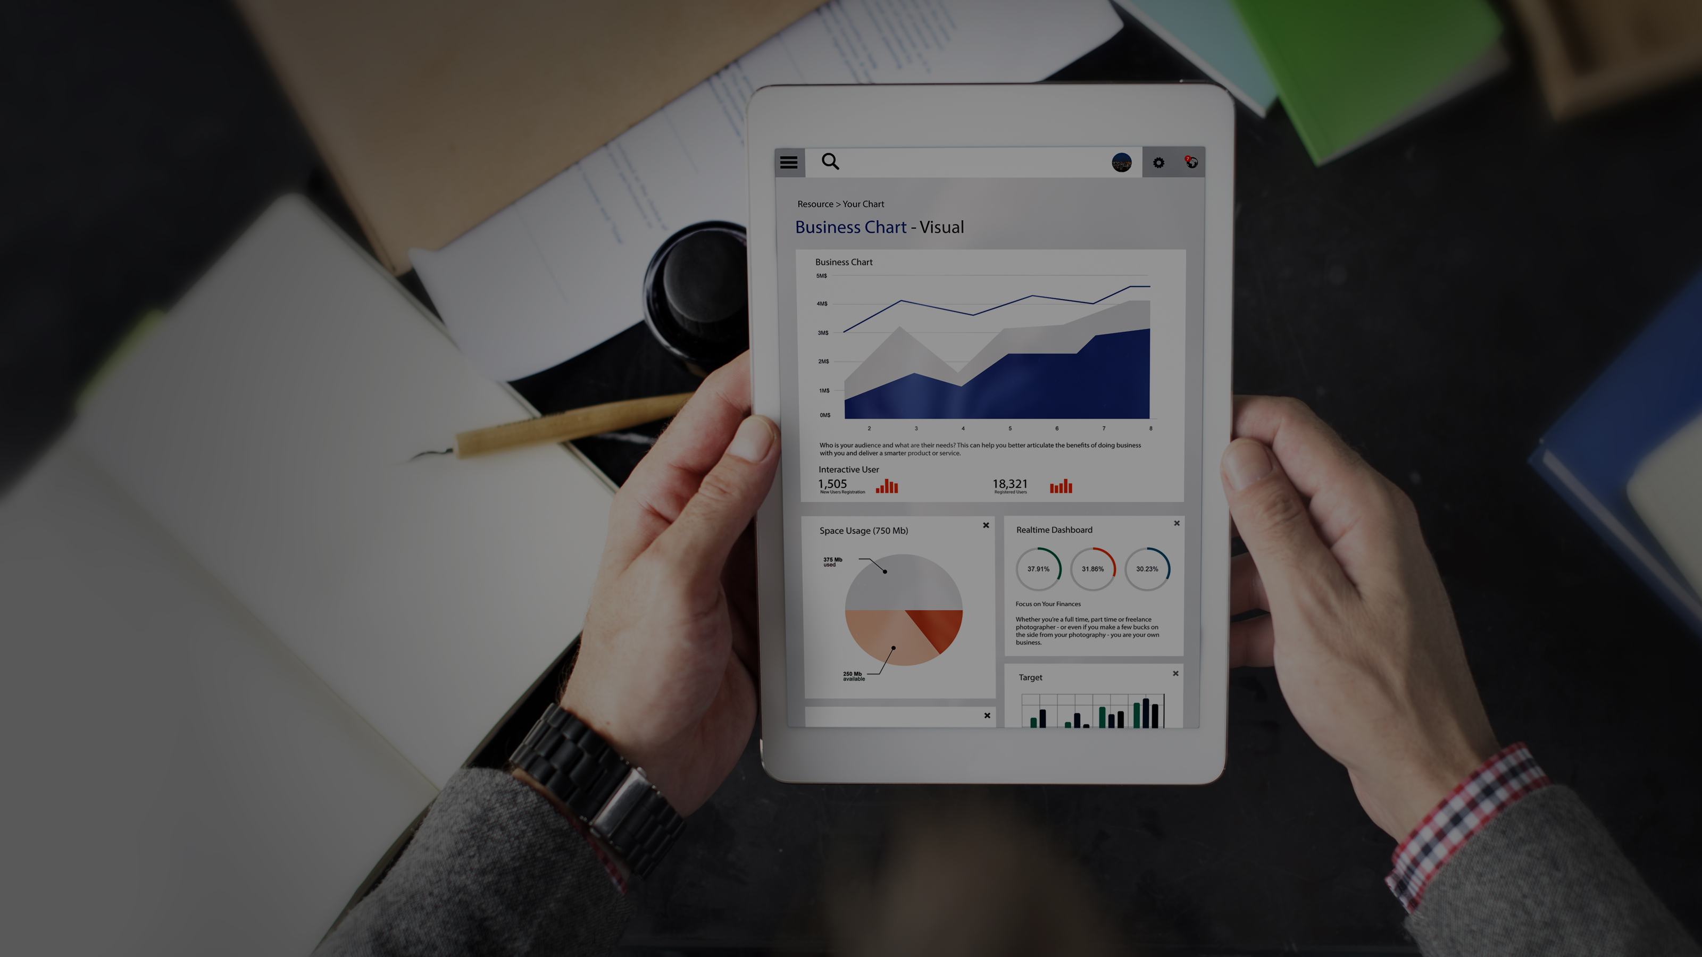

Systems Limited
AI and Machine learning Competency
www.systemsltd.com

Slide 2


INTRODUCTION
Qaisar Tanvir
Sr. Data Scientist at Systems Ltd, Machine Learning and Data science Department
A Data Scientist and a Data enthusiast with professional experience in employing machine learning algorithms and tools for image classification, text analytics and financial data predictions
Contact:
Email id: Qaisar.tanvir@outlook.com

Slide 3
How (and whether) to implement machine learning in your organization

Slide 4
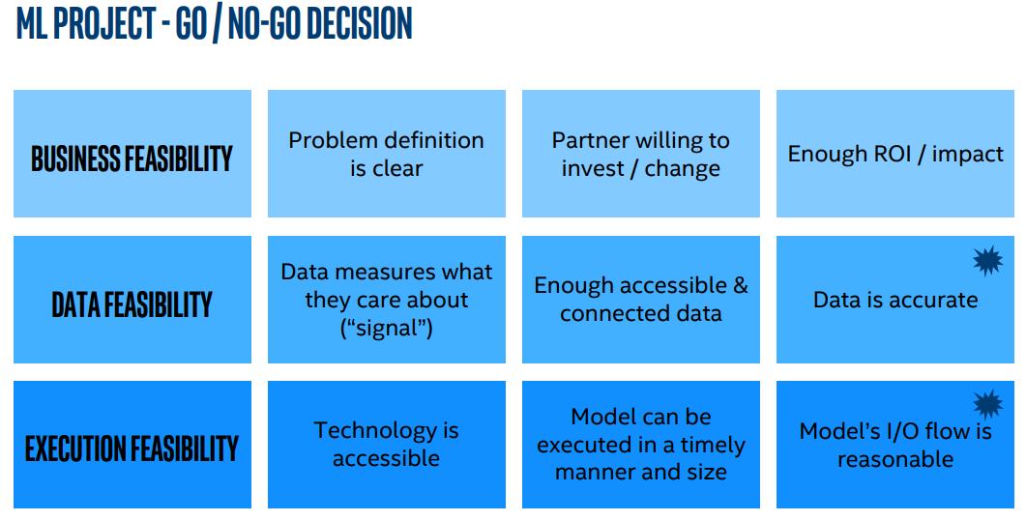

Slide 5
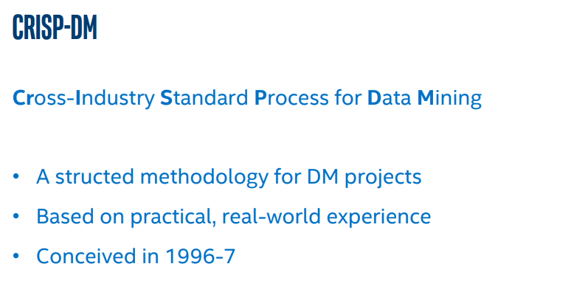

Slide 6
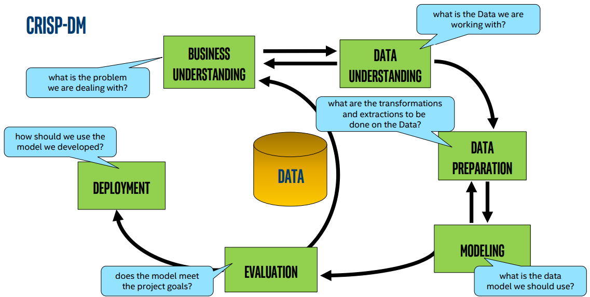

Slide 7
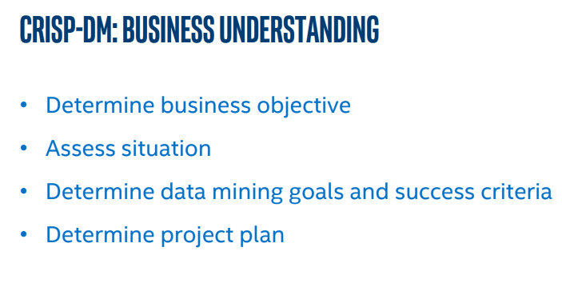
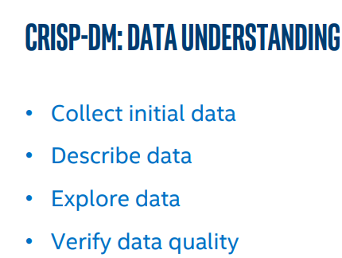
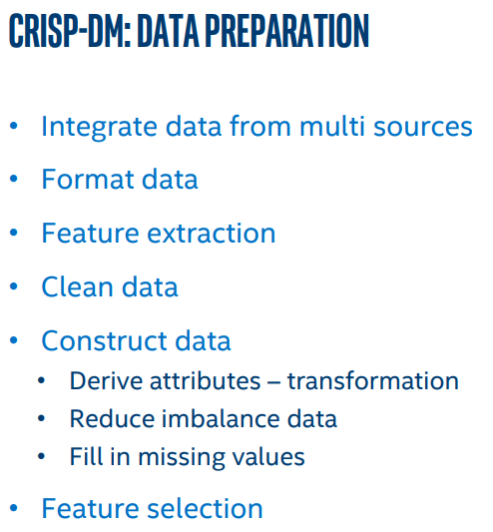

Slide 8
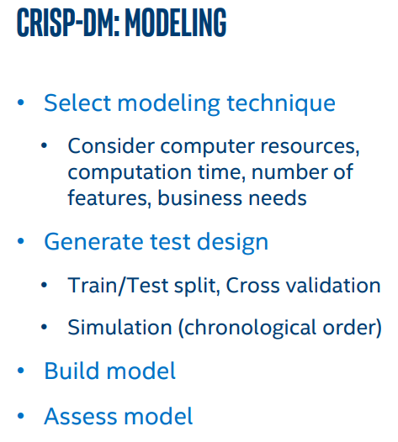
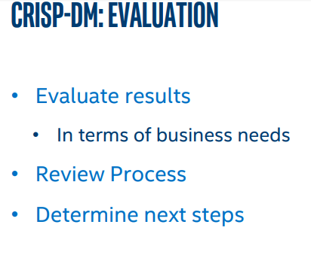
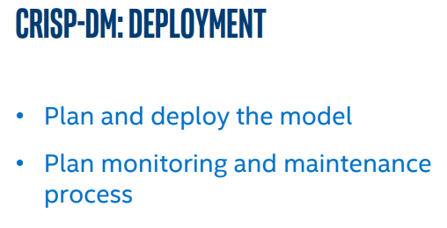

Slide 9
Resources for Machine learning and AI
Finding interesting things happening in AI Research
YouTube
Two Minute Papers (60K subscribers, 3.3M views)
Intuitive Ai/ML projects, tutorials and demos.
YouTube
sentdex (225K subscribers, 21M views)
Siraj Raval (140K subscribers, 5M views)
DeepLearning.TV (42K subscribers, 1.7M views)
Codes and Projects (Most are open-source)
Github.com
Kaggle.com
Interesting Datasets
UCI Datasets : https://archive.ics.uci.edu/ml/index.php
Kaggle.com

Slide 10
Resources for Machine learning and AI
Courses and Certifications
Online Learning
Edx
Udemy
Udacity
Coursera
Books
https://github.com/janishar/mit-deep-learning-book-pdf
https://www.tableau.com/learn/articles/books-about-machine-learning

